Slide 1
SEED CERTIFICATION USING BLOCK CHAIN TECHNOLOGY
Amazon Smbhav Hackathon –Build FOR INDIA

Slide 2
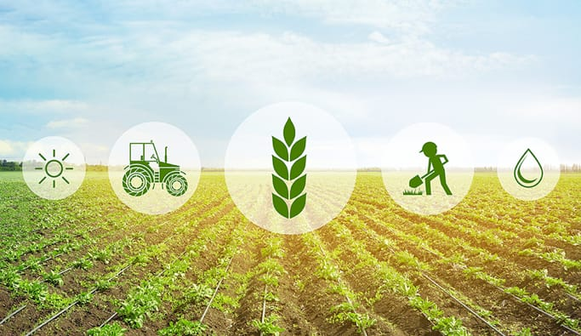
CONTENTS
1.Information
2.Why blockchain in agriculture
3.Introduction
4.Blockchain Solve this problems
4.Need of innovation
5.Novelity
6.Feasibility
7.Companies using agricultural blockchain
8.Market Value
9.Scalability of technology
10.Risk assessement
11.Impact
12.Conclusion
13.Team name and leader

Slide 3
INFORMATION
Seed Testing Using AI-FRONTEND
FOCUS AREA: Block chain technology
1. Frontend of the app is to determine
genetic purity, optimum moisture ,shape& color of seed.
2. Backend of the application contain transactions
between peer 2 peer wallets in order to secure transaction.
we can able to analyse seed and it’s quality even it’s morphological character and its germination period of time .
Color detection,
Crack detection,
Regression.
Block Chain Technology
[Ethereum farmer’s transaction]-BACKEND
Secured transaction
Between farmer and seed agency.

Slide 4
Why block chain in agriculture?
Blockchain is a technology that allows users to transfer value or assets between each other without the need for a untrusted intermediary.
Analogous to triple entry accounting.
Reduced cost of verification by eliminating the untrusted intermediary.
Reduced cost of networking by being accessible peer to peer.
With 40% of the global workforce, agriculture is one of the leading job providers in worldwide.
Huge, important, industrialized, but very complex industry.
Heavily regulated, highly subsidized and complicated.
Many blockchain agricultural solutions are emerging – maybe the last frontier.

Slide 5
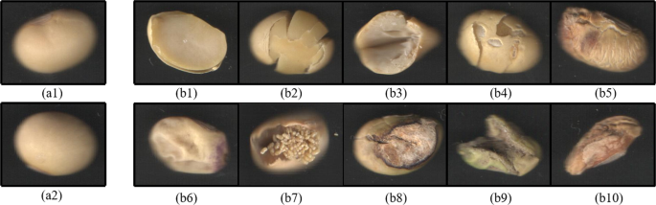
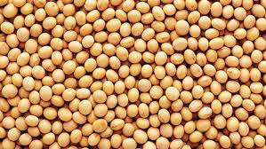

INTRODUCTION
43 million hectares are used for maize seed .
Major requirement for 1.29 millions tons of certified seed & 0.43 million labs for seed productions.
Monitoring of 130 seed laboratory and 718 seed testing districts in the country is difficult task .
Every Seed Laboratory have more than 6 districts , for which is physically seeding test is impossible.
Seed quality consequently requires the need to control and monitor the testing seeds
By using this method we can obtain efficient results within short span of time , which will be useful for seed testing labs

Slide 6
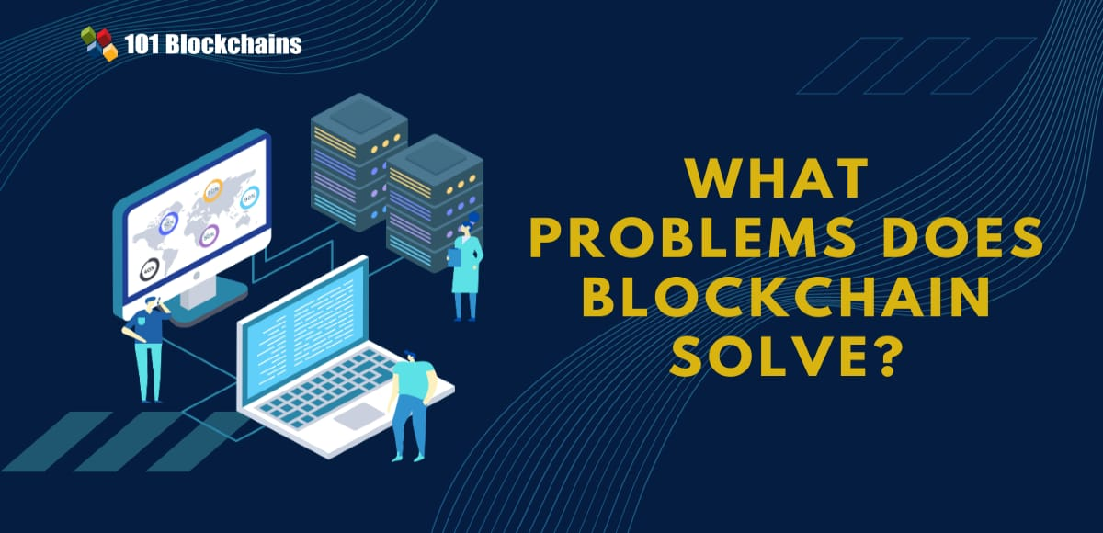
BLOCK CHAIN SOLVE THIS PROBLEMS
1. Improve transparency in the supply chain.
2. Traceability for consumers.
3. Expand financial options for farmers.
4. Provide immediate payment on delivery. 5. Provide farmers with direct access to suppliers and transparent transaction information.

Slide 7
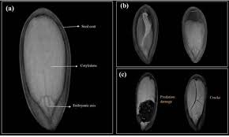
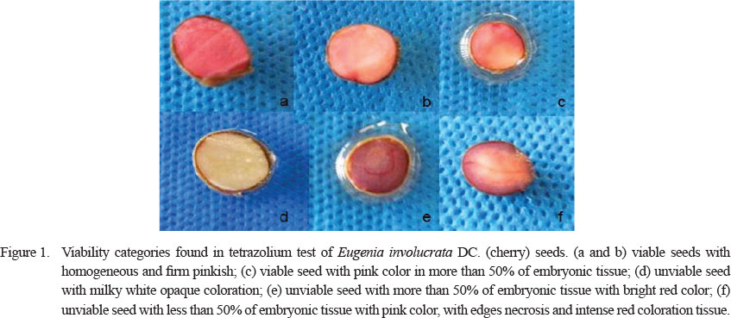
Need of Innovation
Efficiency of seed testing labs will take many samples of seed
Lack of effective Monitoring Mechanism.
For production differentiation and Brand Imaging
Retailers are not equipped to store the seed for one whole year
Cost effective tool and less man power intensive. Results can be obtained faster.
It will improve atmost 20 times for 200 samples of seed by using software.

Slide 8
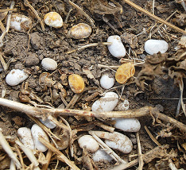
NOVELTY
Traditional germination of seed testing is done by grow out method , germination percentage which by visualizing will identify the uniformity of seed.
Our method will apply Image analysis method using computer software (RSGES) using Digital Image processing and an artificial neural network technique and deep learning .
Artificial neural network has a ability to find magnetic induction of 150 and 200 Mt for better germination
This method will replace time consuming physical grow up methods.
The automated Data will be stored in distributed cloud technology algorithms.
ALGORITHMS
1. Pre-process the sample image based on size, colour, moisture, genetic purity, worm infections, remove background noise and converts the physically preprocessed image to binary image.
2. Training Artificial Neural Network embedded in the software to use ANN classifier to divide image into different quality.
3.Monitoring and Processing of seeds by comparing with the library of seeds within few seconds.

Slide 9
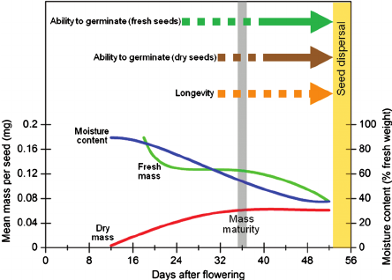
Feasibility
Samples of the seed are taken uniformly .
30 days is taken in laboratory to test the samples of the seeds
The data of the samples of rice seed is stored in cloud computing after germination test
Technically feasible and it can be used in seed laboratories as it will be accompanied by algorithm and cloud computing across the country.
Germination testing
1.Purity testing,
2.Tetrazolium Testing makes testing process complicated .
3. By using ANN based Image analysis , it is a cost effective method for Indian economy and diversity of seed growth.

Slide 10

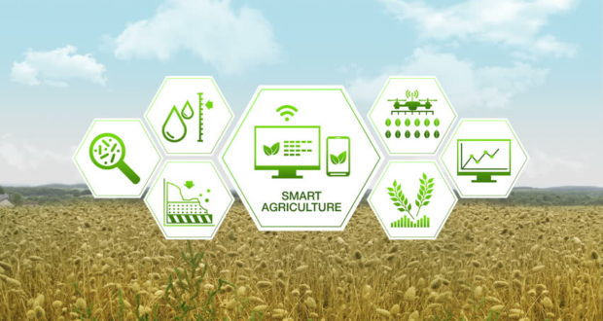
COMPANIES USING AGRICULTURAL BLOCKCHAIN
Filament – Smart Farm
SkuChain, Provenance – Food tracking (Application: tracing tuna on blockchain)
Farmshare – Community sponsored agriculture Blockchain agricultural in global
Full Profile – Australia
Wakchain – Africa

Slide 11
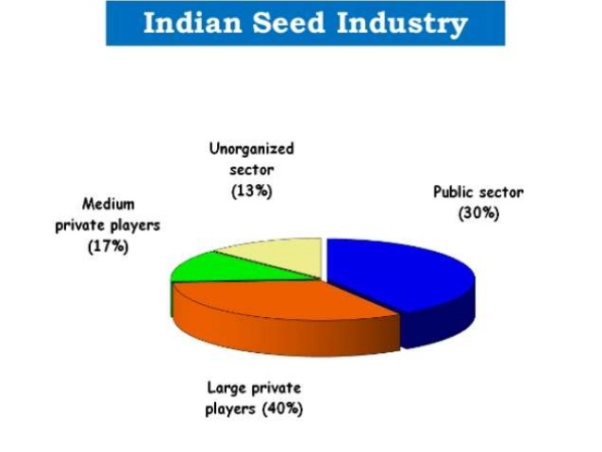
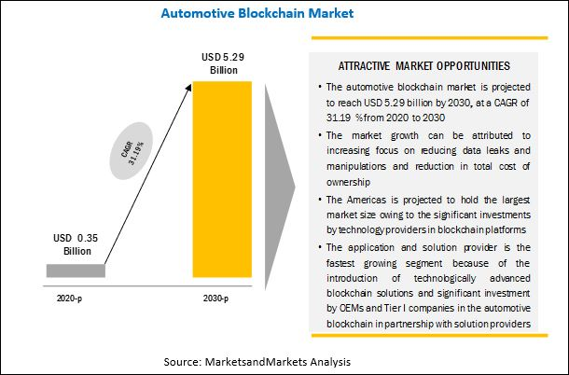
MARKET VALUE
0.43 million of maize seeds is about Rs.35 per kg In the market prices.
Seed testing is tremendous based on seed samples of annual basis of the customers for the upfront payment of state government.
Revenue will be generalized based on the samples of the seed .
Market value is based on Annual basis of the customers (State Government).
Indian seed estimation reaches value of $3.6 billion in 2020 growing annual rate of CAGR of around 17 percent.
Distributed ledgers and other block chain capabilities are rapidly expanding financial benefits.

Slide 12
SCALABITY OF TECHNOLOGY
Cloud based services and enabling existing data center and infrastructures to use the technology from any place, based on the demand.
Creating a Block chain sand box for environment for developing and testing the D-apps.
Bit coins have scalability of 4 transaction in a second.
Financial benefits of block chain technology such as instant settlement, Improves capital optimization, Reduces counterparty risks, Improved contractual performance due to smart contracts, increase transparency

Slide 13
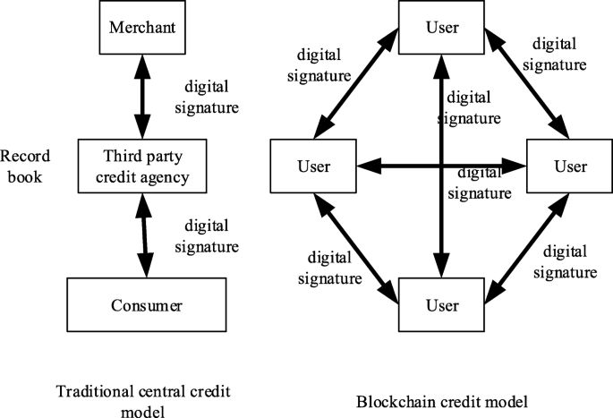
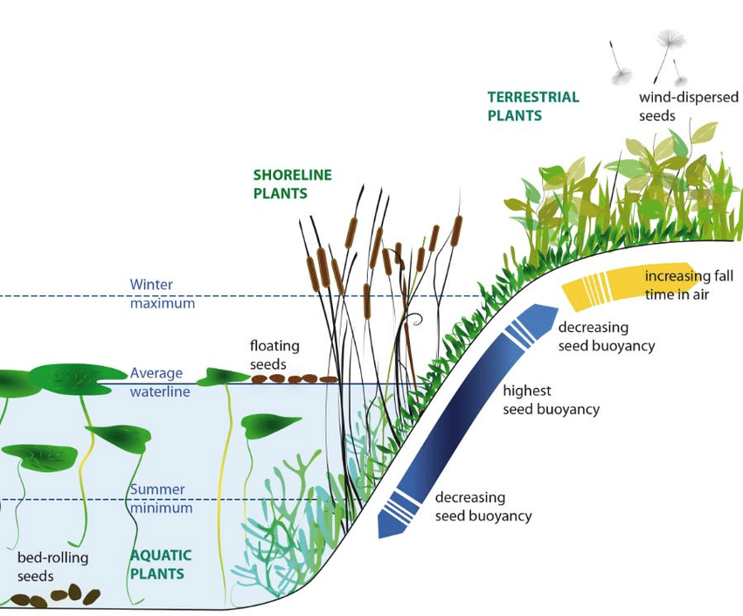
RISK ASSESSMENT
Climatic disasters such as flood , hurricane and worm attacks incase can be resolved using alternatives by using this technology.
The major uses of technology in seed production requires less man power.
Farmers are unwilling to take up other transactions/technology .
The cloud database has to be enabled with high security encryption cryptographic algorithms. Highly secured server is required
Seminars/Workshops can be conducted to create awareness for using the technology

Slide 14
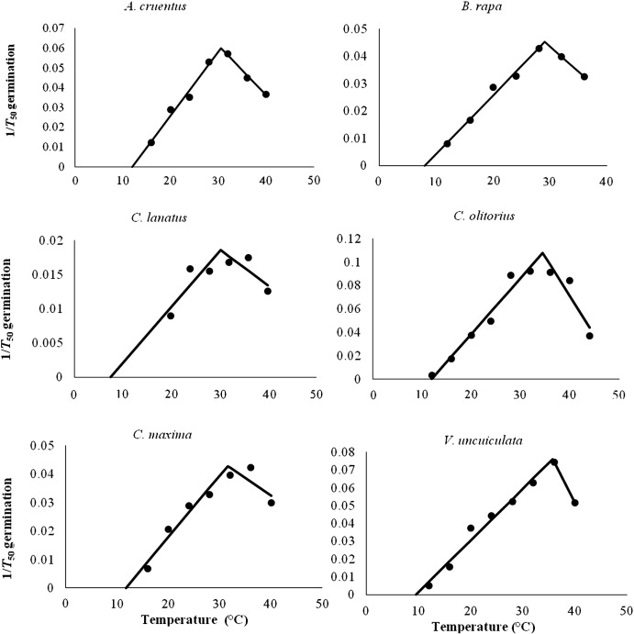
IMPACT
130 Labs and 700 testing's reduces the time for testing and accuracy
10% improvement of quality of seed and increase in income
Increase in accuracy seed quality & easily sorting principles are used by using ANN.
Temperature is main factor for seed germination
The increase in growth seed production 14 billion USD by 2025 using block chain technology

Slide 15
Linking blockchain with existing systems for a single source of truth
More than a simple identifier, fetching the data stored on the blockchain allows any entity to access details about that particular item
To ensure trust in a system, there should be a single source of truth (SSOT) for each piece of information
Accepting raw materials: The record held on the blockchain are accessible to the item as a QR Code, RFID tag, or using any other hardware technology
Registering items: When raw materials and turned into new products, the corresponding assets need to be updated and transformed accordingly
Accepting items: Just as inputs were transferred on the blockchain when physically arriving at the factory, outputs are transferred to the next actor in the chain when leaving the facility.

Slide 16
Blockchain CommunitySupported Agriculture
Community-supported agriculture: an alternative economic model for the production and distribution of locally grown food FarmShare is an evolution of the community-supported agriculture (CSA) mode
Blockchain technology removed settlement risk for wheat growers
Real-time payments and settlements in blockchain allow growers to get paid for their grain instantly
Distributed ledgers in blockchain can democratize access to finance by creating rich and secure data

Slide 17

Conclusion: Future of Blockchain technology in agriculture
No large-scale commercial adoption of blockchain yet: still many bottlenecks to remove
The challenge now for blockchain, and agricultural technologies is connecting the technology to viable business models and compelling use cases
Blockchain technology has the ability to fundamentally transform the agriculture industry.
All the start-ups mentioned above are working hard to do just this.
Farmers in the Western world have always been eager adopters of technologies that make sense and deliver real value.
Agriculture as the last frontier of blockchain

Slide 18



TEAM NAME: Alpha_123
A.JESHRON SONALI,
ja2943@srmist.edu.in
(or)
jeshronsonali125@gmail.com
B Tech 3rd year ECE department,
SRMIST RAMAPURAM,
CHENNAI.
S.MIN OVIYA
ms8997@srmist.edu.in
(or)
moviasuresh16@gmail.com
B Tech 3rd year ECE department
SRM IST RAMAPURAM
CHENNAI

